Slide 1
Hotel Segmentation
BY Feri dwi saputro

Slide 2
Introduction
Graduation is the dream of all parents to their children who have completed their studies. Sometimes many parents come all the way to attend the graduation process of their child.
Usually those from out of town will stay at the closest hotel to the university before coming to the graduation ceremony so as not to be late and save time. Interesting places around the hotel can also attract people to stay.
To determine the recommend hotel, we can use the clustering technique to divide the nearest hotel group into several segments or groups.

Slide 3
DATA REQUIREMENT
Based on definition of our problem, we need data about:
Hotels around the Indonesian Computer University with radius 500 meter.
Places near the hotel with coordinate location.
The data is retrieved using the Foursquare API.

Slide 4
foursquare api
To access the Foursquare API, we need the following tokens :
CLIENT_ID : Your Foursquare Client ID
CLIENT_SECRET : Your Foursquare Client Secret
ACCESS_TOKEN : Your Four Square Access Token
VERSION : Your Foursquare Version

Slide 5
Hotels DATA
We will take hotel data around UNIKOM with a radius of 500 meters. The steps taken include:
Create URL with predefined parameters.
Fetch hotel data in json file format.
Converts json files to tabular data.
Perform data cleaning such as column filtering and remove similar hotel names.

Slide 6
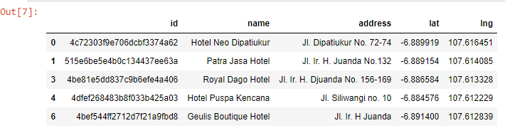
SAMPLE hotels data

Slide 7
NEARBY places data
Next, retrieve data on the closest places around each hotel using the Foursquare API
Create URL with predefined parameters
Get only relevant information for each nearby venue
Save into dataframe
Get list nearby places each hotel

Slide 8
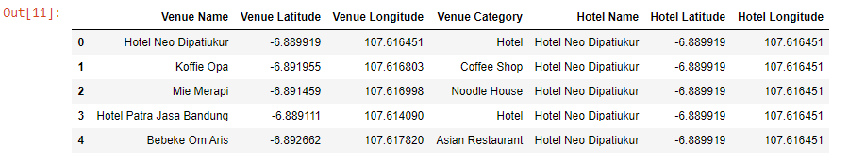
SAMPLE NEARBY Places

Slide 9
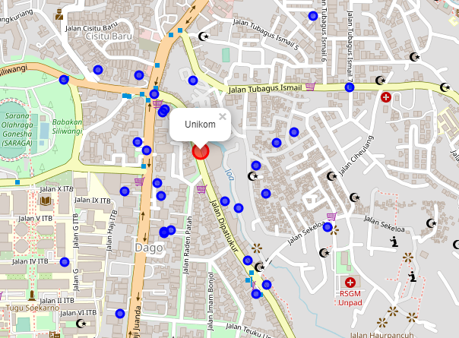
HOTELS MAP

Slide 10
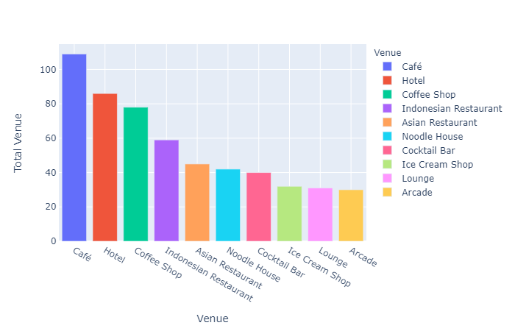
Top 10 nearby places

Slide 11
K-Means clustering
Removes the hotel category in the Venue Category column.
One Hot Encoding the Venue Category column.
Use k=5 to find clusters.

Slide 12
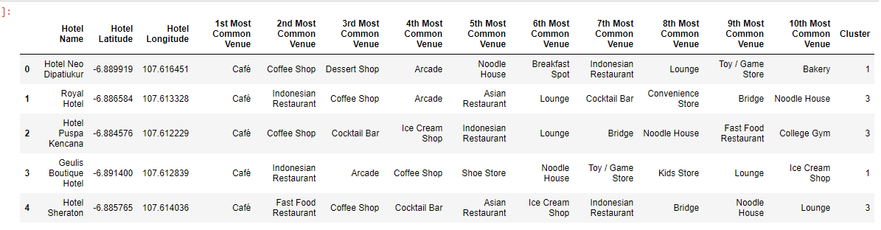
SAMPLE RESULT CLUSTERING

Slide 13
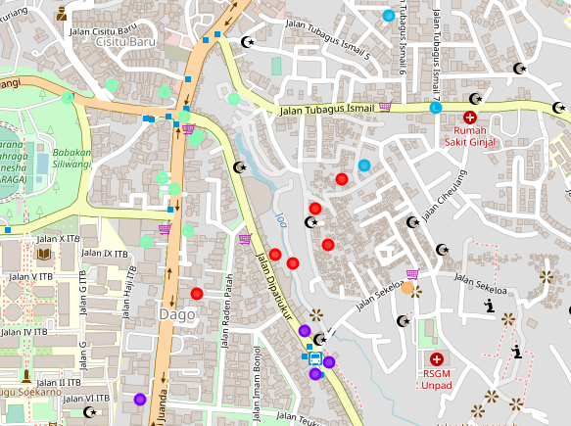
CLUSTERS MAP

Slide 14
CLUSTER DEFINITION
Cluster 0 (red) is closer to UNIKOM but nearby places are less popular and some hotels require detour access.
Cluster 1 (purple) is located before UNIKOM with a fairly strategic location but it appears that there are other universities that are possible if the road is quite busy. Apart from that there are bus stops too.
Cluster 2 (blue) is located quite far from UNIKOM and less strategic places around it.
Cluster 3 (sky blue) is located in the most strategic location, although not too close to UNIKOM, road access is quite easy because it is the main road.
Cluster 4 (orange) does not look strategic, other than that it is not on the main road.

Slide 15
conclusion
Hotels in Cluster 3 are highly recommended because there are more hotel choices depending on your taste and road access is easier. In addition, the places around the hotel are more or less the same because they are included in the top 10 nearby places.
Maybe it can be developed further because the distance of the hotel to UNIKOM is also affected by the traffic flow as well.

Slide 16
Thank you

